Slide 1
Outline
Eulerian graphs
Hamiltonian cycles
Hamiltonian paths
Fault tolerant Hamiltonian
Globally 3*-connected
Bipartite variations
Cubic 4-ordered Hamiltonian
Mutually Independent Hamiltonian paths and cycles
Keeping the question: What to do next?

Slide 2
Euler Graphs
Lih-Hsing Hsu

Slide 3

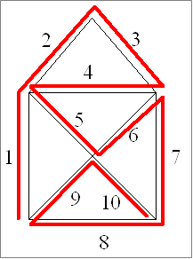

Slide 4
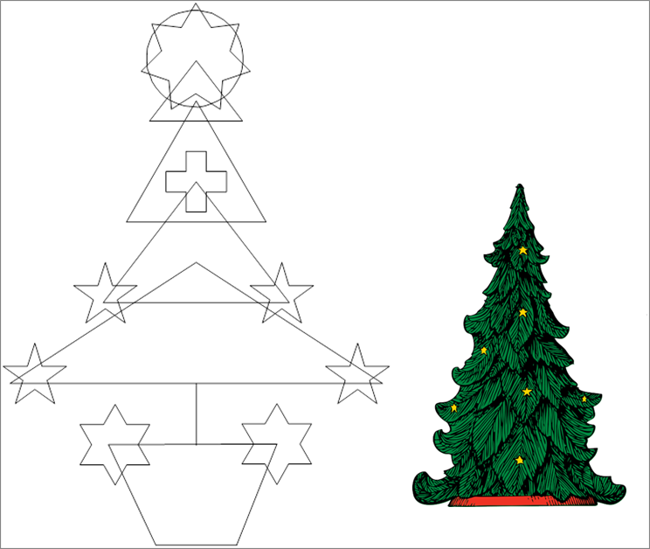

Slide 5

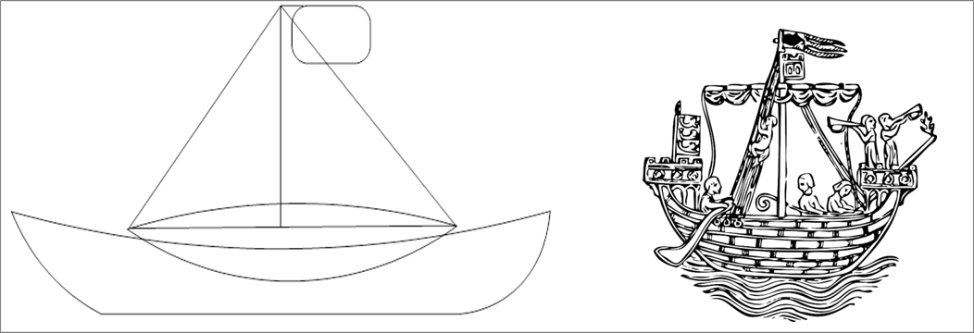

Slide 6
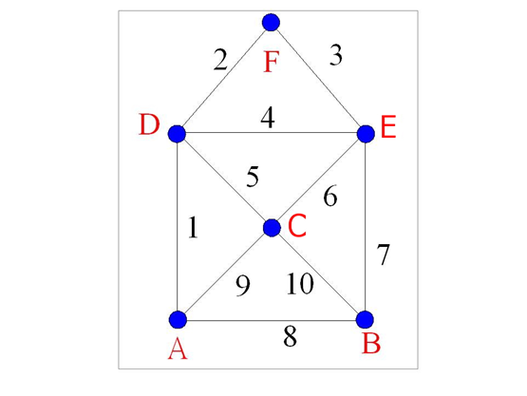

Slide 7


Slide 8
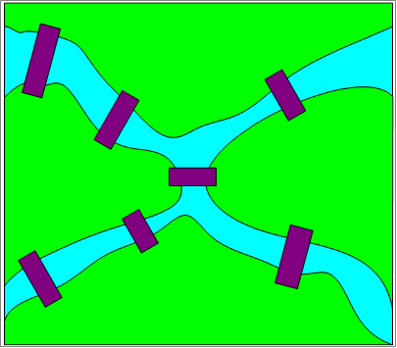

Slide 9
Theorem. A connected graph is Eulerian if and only if all vertices of even degree.

Slide 10
Minimum number of strokes
Figure 1-12

Slide 11

Drawing puzzles
creative

Slide 12
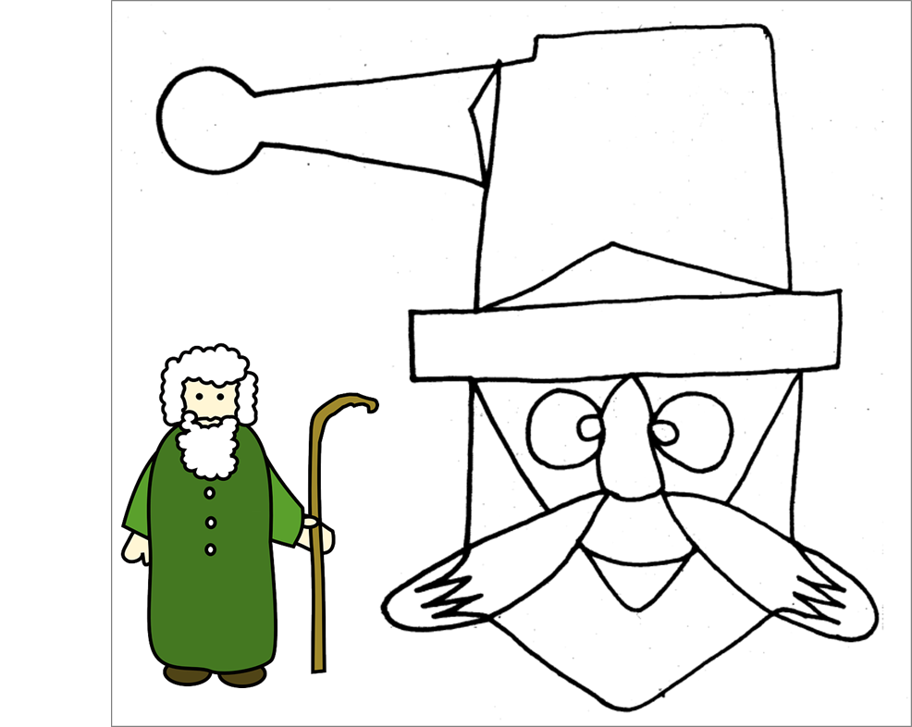


Slide 13
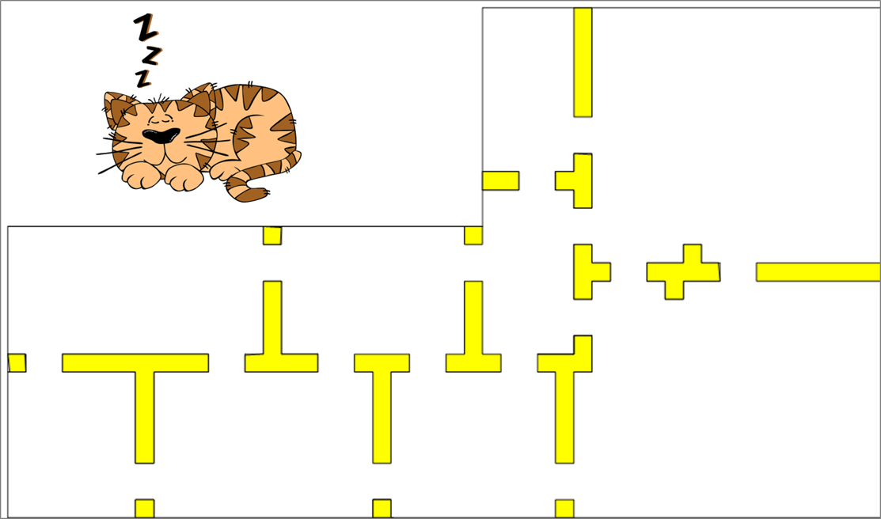
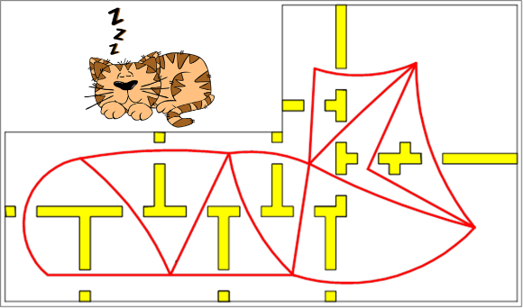

Slide 15
Number of Eulerian circuits

Slide 16
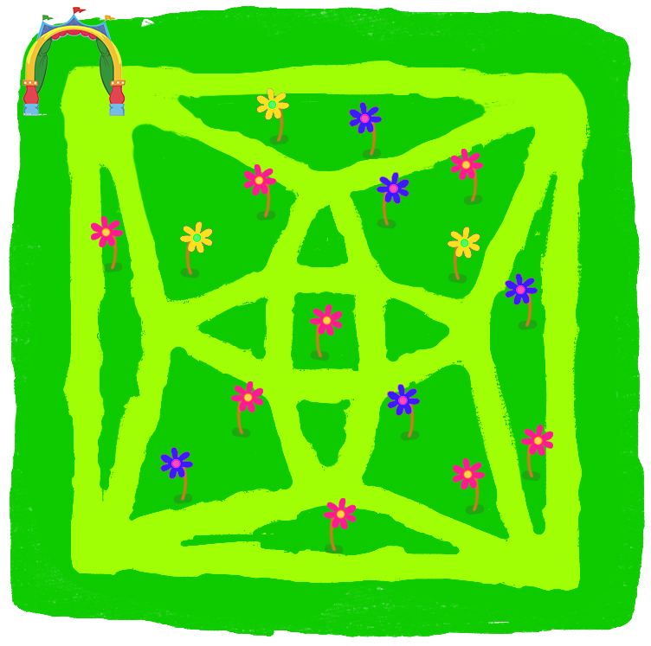

Slide 17
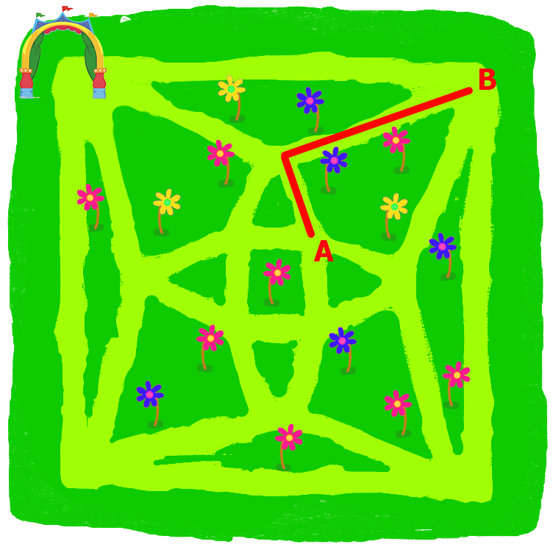
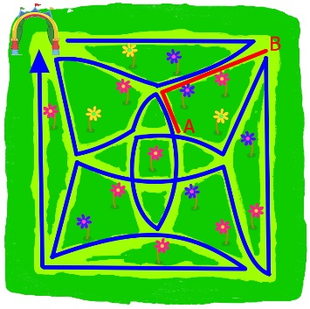

Slide 18
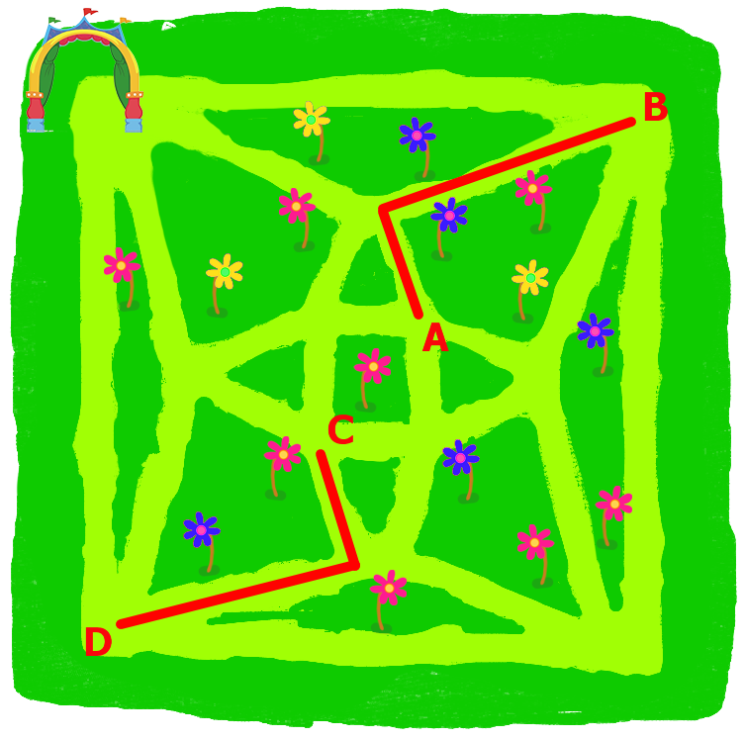
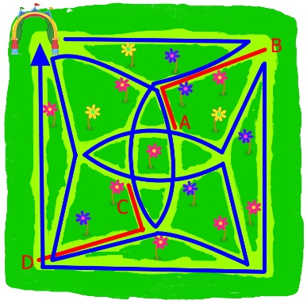

Slide 19
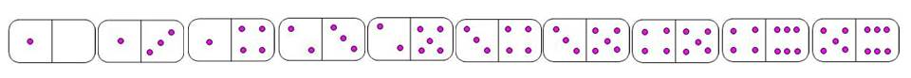


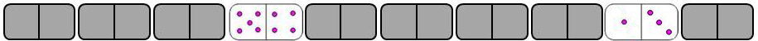
Figure 1-26
Figure 1-27
Comment: You learn Data structures from the puzzle.

Slide 20
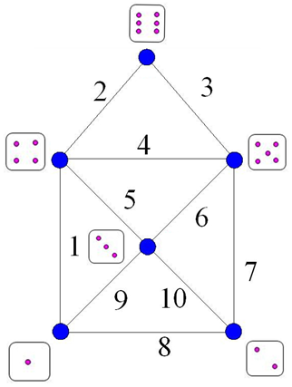
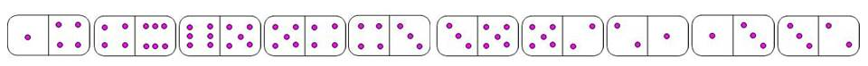
Figure 1-28

Slide 21
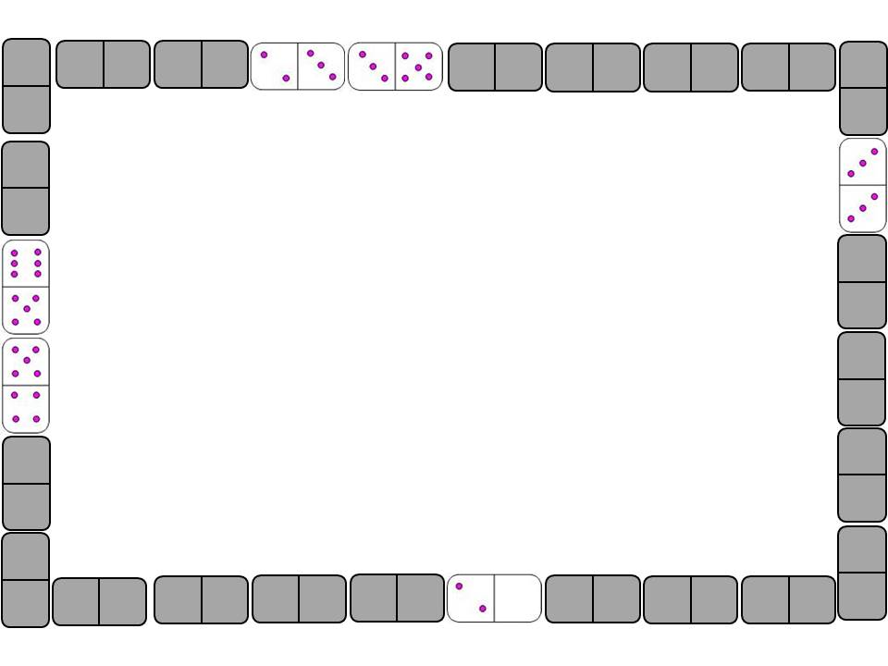
Notes:
加答案

Slide 22
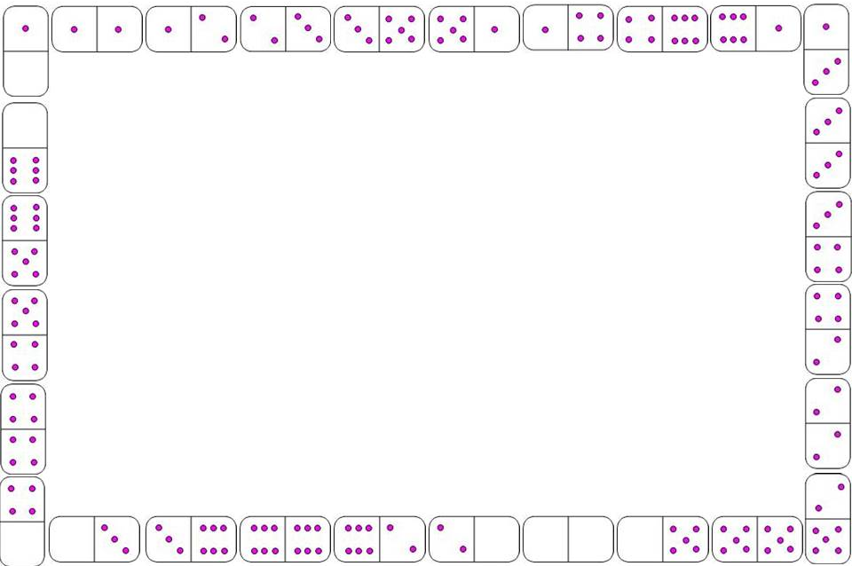

Slide 23


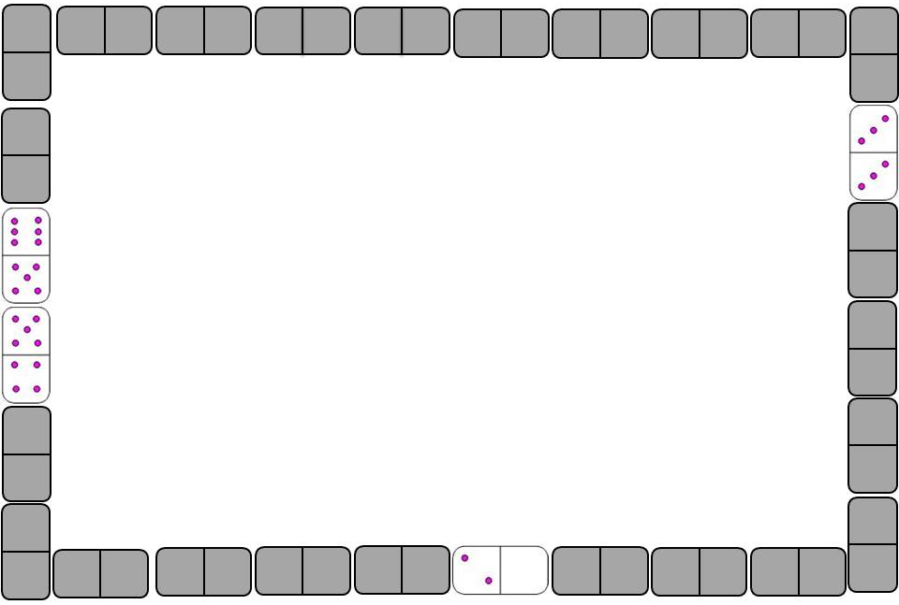
separate

Slide 24
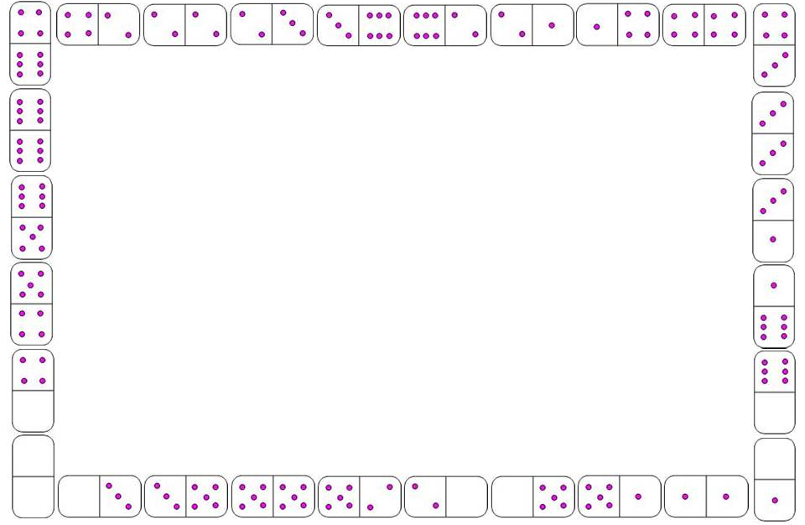

Slide 26
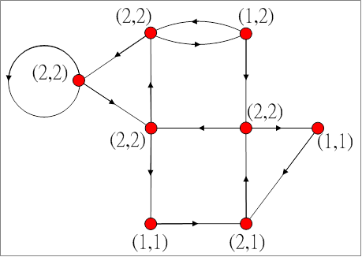

Slide 27
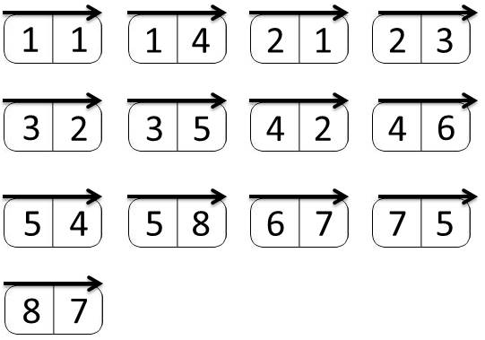
Figure 1-37

Slide 28
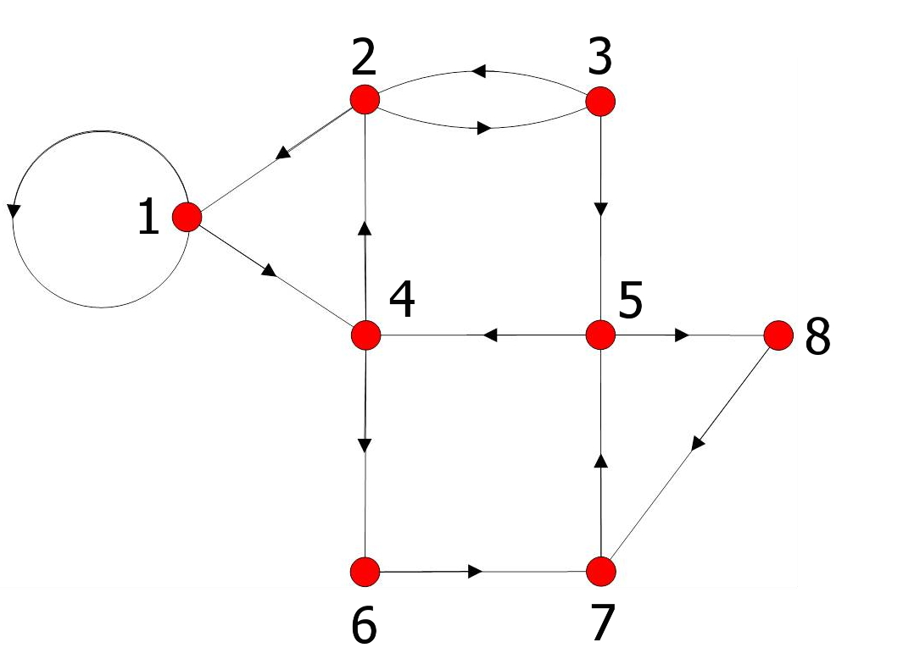
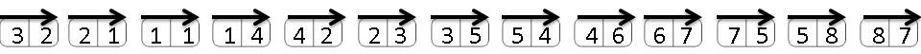

Slide 29














Now, we replay the domino puzzle again by assigning the 28 dominos with all the following conditions:
, and , are in the prescribed position.
and are adjacent to each other.
and cannot be adjacent.
and are polarized as and .
and are polarized as and .

Slide 30
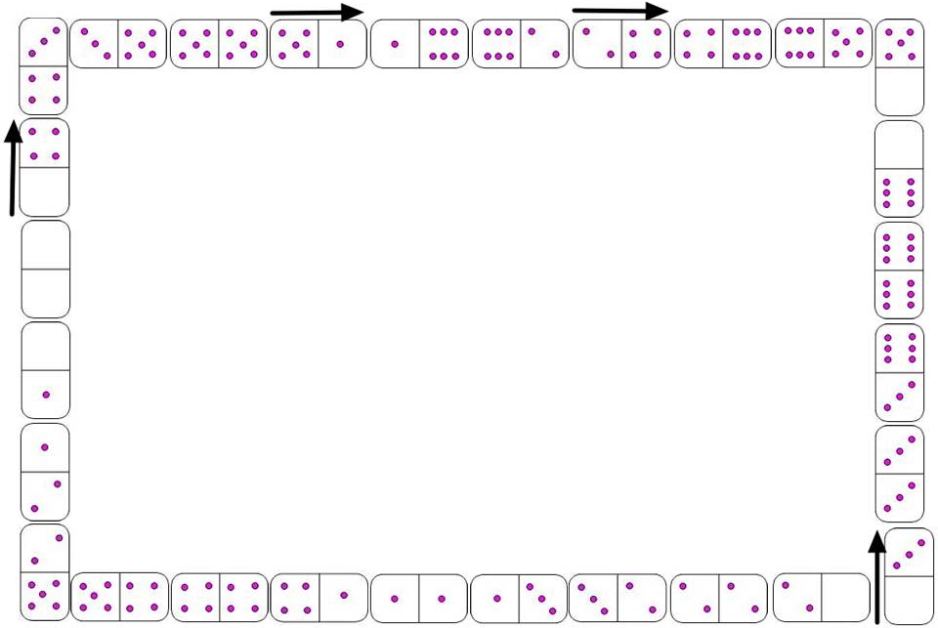

Slide 31
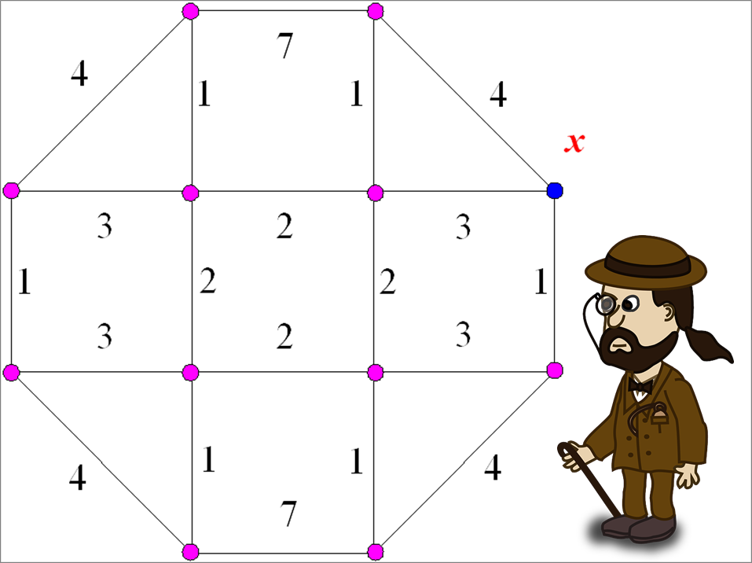
Application: Chinese Postman problem
Guan, M., “Graphic programming using odd and even points,” Chinese Mathematics, 1, 273, 1962.

Slide 32
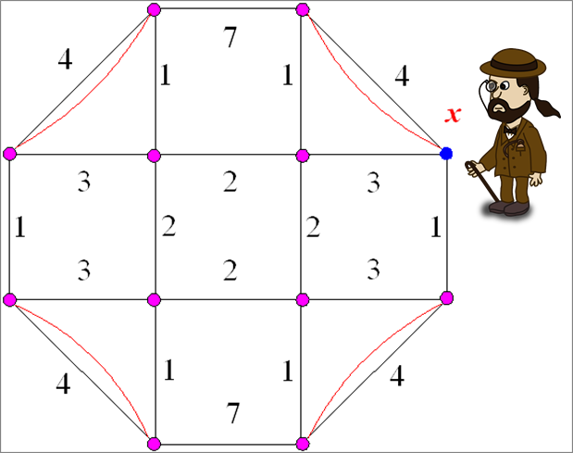
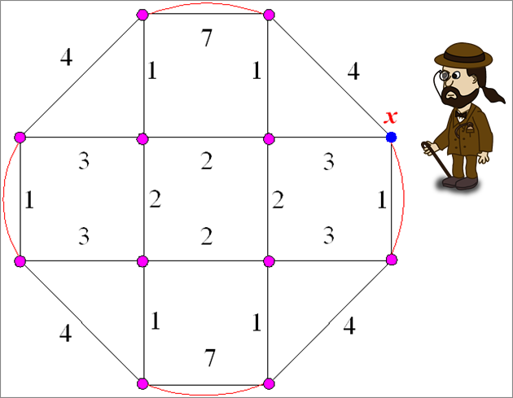

Slide 33
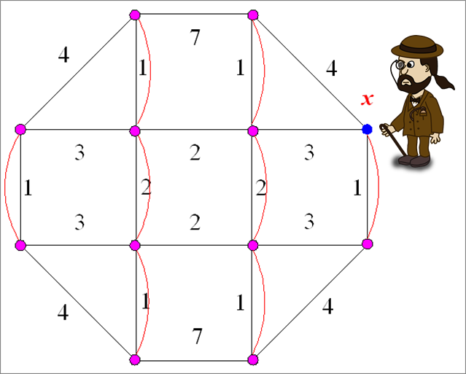

Slide 34
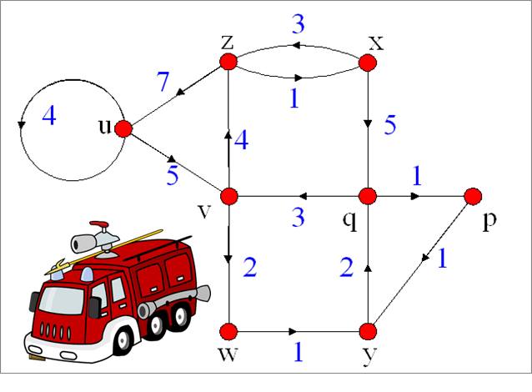
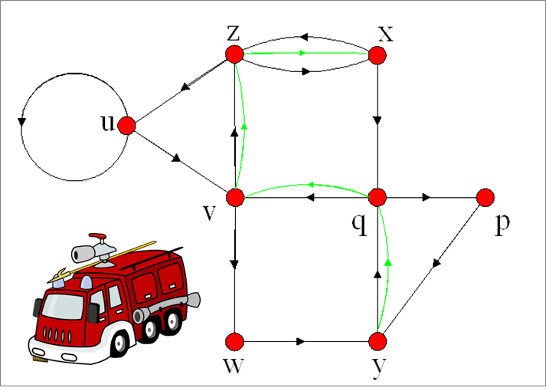
Directed Chinese Postman problem
Tucker, A.C. and Bordin, L., “A model for municipal street-sweeping operations,” Case studies in Applied Mathematics (CUPM), The Mathematical Association of America, 1976.

Slide 35
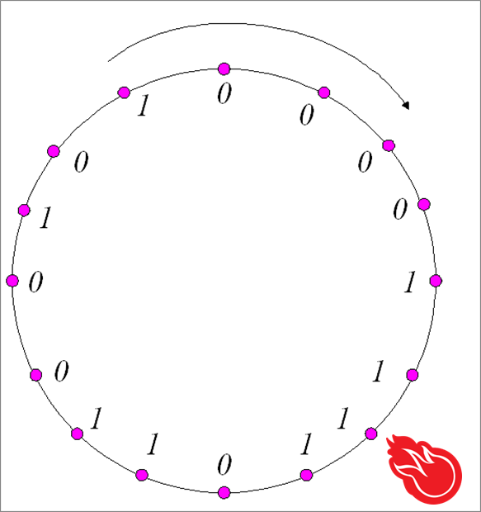
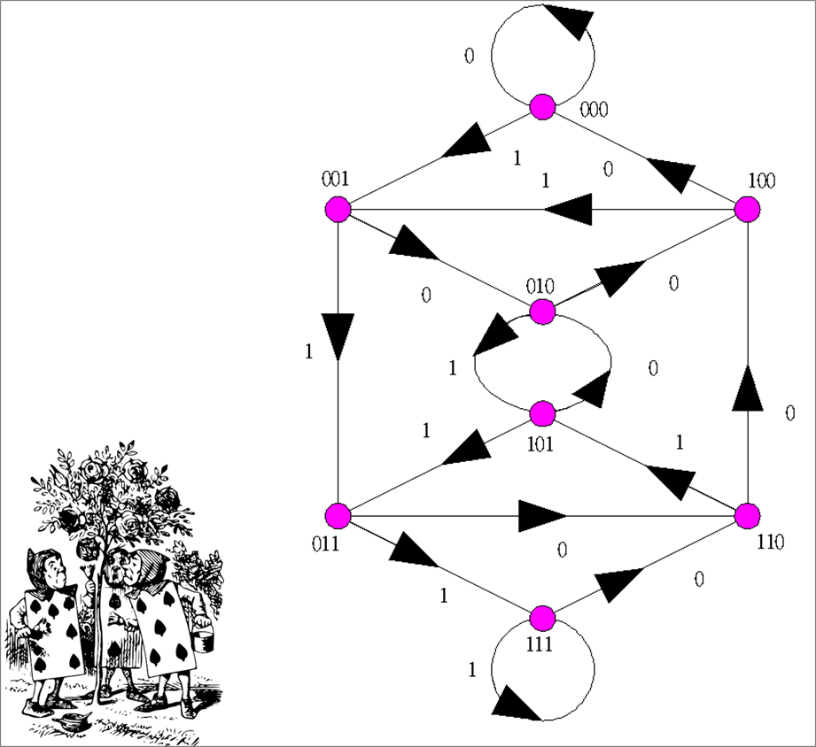
Drum design
Good, I.J., “Normal recurring decimals,” Journal London Mathematical Society, 21, 167, 1946.

Slide 36
Just my comment of Eulerian graphs
Eulerian graphs
Algorithm: Linear time.
Rather easy
Note: Complexity: P, NP, NP completeness

Slide 37
Publication of Eulerian graphs: (Publication is difficult)
Not publishable completeness (NP-Complete --- Just joking)
Yet, I have one result.

Slide 38
The Recognition of
Double Euler Trails in
Series-Parallel Networks
Ho, T.-Y., Sung, T.Y. Hsu, L.H., Tsai, C.-H., and Hwang, J.-Y., The recognition of double Euler trail for series-parallel networks, Journal of Algorithms, 28, 216, 1998.

Slide 55
a
b
a
c
b
c
a
a
b
b

Slide 56
a
b
a
d
c
d
b
c
c
d
a
b
c
b
e
a
f
e
d
f

Slide 59
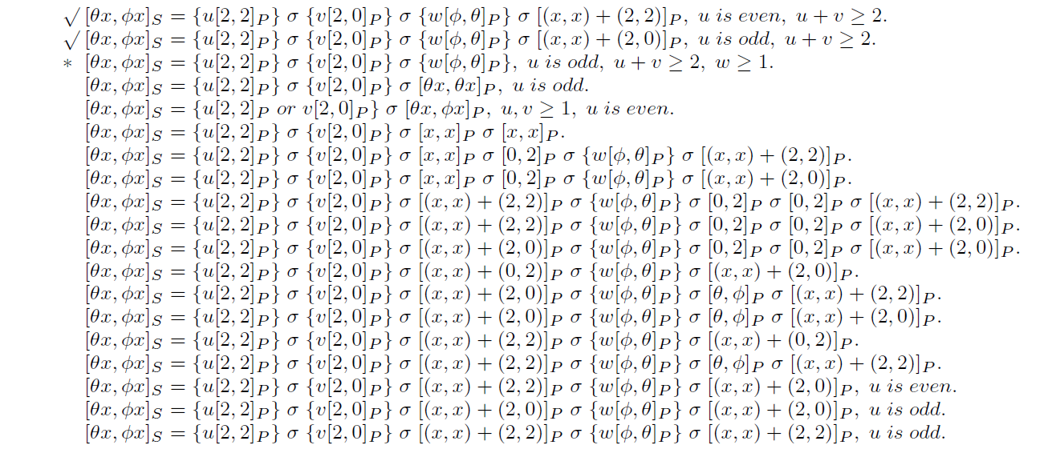

Slide 64


Slide 66
Method: using the rules in slide 57-63.

Slide 68
Unsolved problems
Track optimization
Data structures
DCT

